Slide 1
Data Encryption Standard

Slide 2
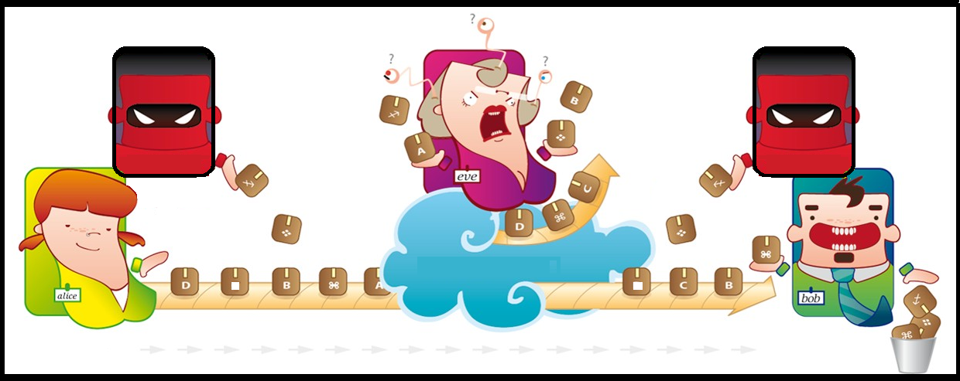
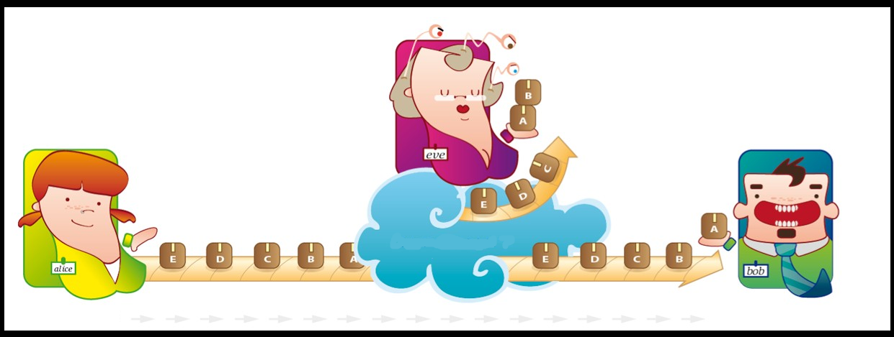
Encryption
Simply Hiding the sent data between Sender and Receiver from any Listeners

Slide 3
Modern Encryption
Modern Encryption Methods
Key Type
Input Type
Symmetric
Private-key cryptography
where the same key
is used for encryption
and decryption,
[DES and AES]
Asymmetric
Public-key cryptography
where two different
keys are used
for encryption
and decryption.
[RS]
Block Ciphers
encrypt block of
data of fixed size
[DES/AES]
Stream Ciphers
encrypt
continuous
streams of data
[One time pad]

Slide 4
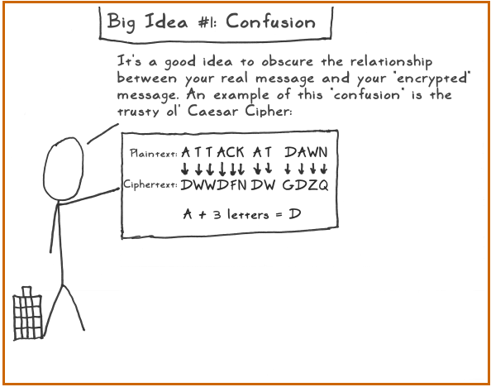
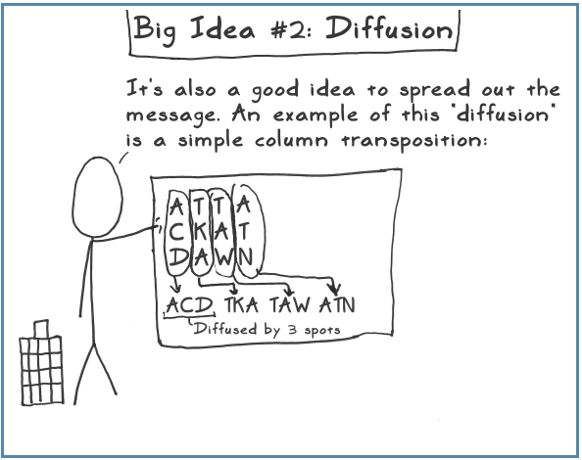
Confusion VS Diffusion
Claude Shannon was concerned with eliminating all cryptanalysis attacks based on statistical analysis.
Diffusion – dissipates statistical structure of plaintext over bulk of ciphertext
Confusion – makes relationship between ciphertext and key as complex as possible

Slide 5
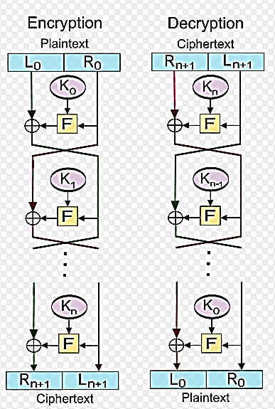
FEISTEL CIPHER
Horst Feistel, working at IBM Thomas J Watson Research Labs devised a suitable invertible cipher structure in early 70's.
Let F be the round function and let K0,K1, . . . . , Kn be the sub-keys for the rounds.

Slide 6
Feistel cont’d
Block Size
increasing size improves security, but slows cipher
Key Size
increasing size improves security, makes exhaustive key searching harder, but may slow cipher
Number of Rounds
increasing number improves security, but slows cipher
Subkey Generation Algorithm
greater complexity can make analysis harder, but slows cipher
Round Function
greater complexity generally means greater resistance to cryptanalysis
fast software en/decryption
ease of analysis

Slide 7
Data Encryption Standard
In the late 1960s, IBM set up a research project in computer cryptography led by Horst Feistel.
The project concluded in 1971 with the development of the LUCIFER algorithm.
LUCIFER is a Feistel block cipher that operates on blocks of 64 bits, using a key size of 128 bits.
Because of the promising results produced by the LUCIFER project, IBM embarked on an effort, headed by Walter Tuchman and Carl Meyer, to develop a marketable commercial encryption product that ideally could be implemented on a single chip.
The outcome of this effort was a refined version of LUCIFER that was more resistant to cryptanalysis but that had a reduced key size of 56 bits, to fit on a single chip.
In 1973, the National Bureau of Standards (NBS) issued a request for proposals for a national cipher standard. IBM submitted the modified LUCIFER.
It was by far the best algorithm proposed and was adopted in 1977 as the Data Encryption Standard.

Slide 8
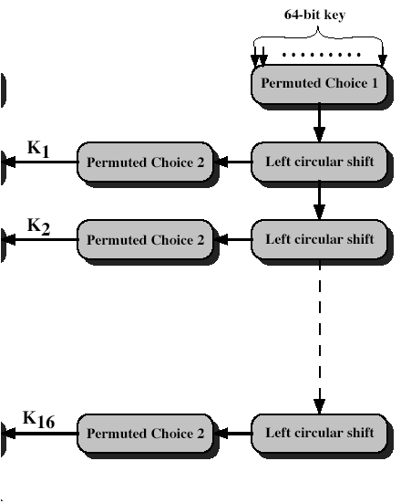
Key Generation
forms subkeys used in each round
initial permutation of the key (PC1) which selects 56-bits in two 28-bit halves
16 stages consisting of:
rotating each half separately either 1 or 2 places depending on the key rotation schedule K
selecting 24-bits from each half & permuting them by PC2 for use in round function F

Slide 9
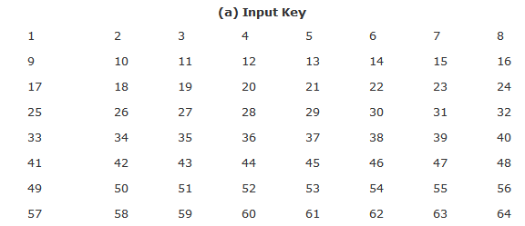
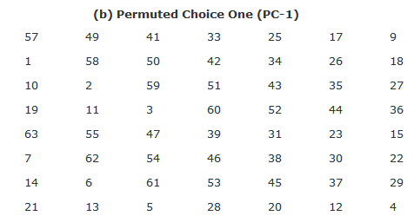
Key Generation cont’d

Slide 10
Key Generation cont’d

Slide 11
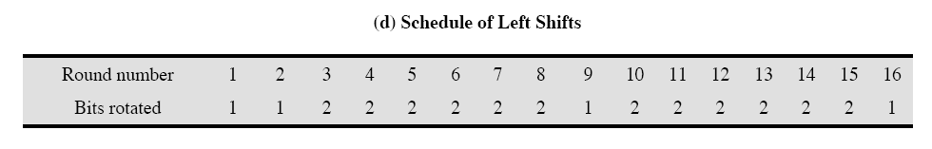
Key Generation cont’d

Slide 12
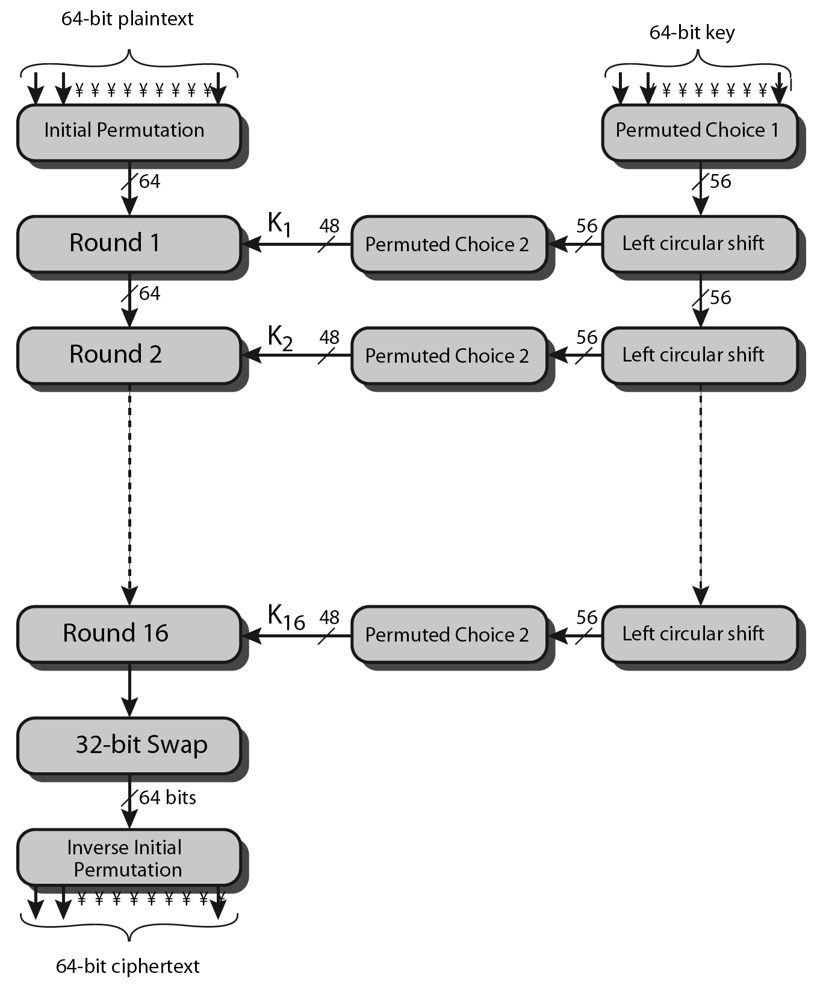
DES cont’d
Phase 1
Phase 2
Phase 3

Slide 13
DES Phase 1/3
Initial Permutation (IP):
The plaintext block undergoes an intial permutation.
64 bits of the block are permuted.
even bits to LH half, odd bits to RH half
The inverse permutation (IP⁻¹)
Y = IP⁻¹(X) = IP⁻¹(IP(M))
The original ordering is restored

Slide 14
DES round

Slide 15
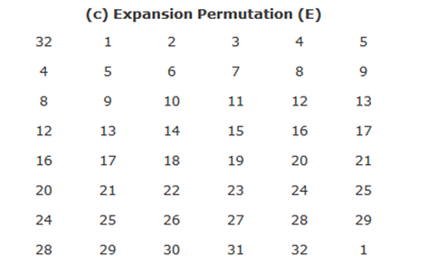
DES round cont’d

Slide 16
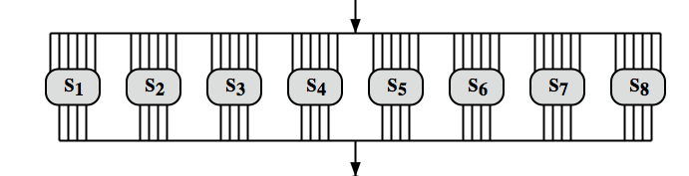
DES round cont’d
Substitution
48 bits → 32 bits
8 S-boxes
Each S-box gets 6 bits and outputs 4 bits.

Slide 17
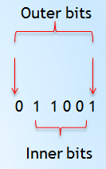

DES round cont’d
S-box number refers to block.
Outer bits 1 & 6 form the row
Inner bits 2-5 form the column
Example : Input : 011001 at S-box1
the row is 01 (row 1)
the column is 1100 (column 12)
Output is 1001

Slide 18
Avalanche Effect
Avalanche effect:
A small change in the plaintext or in the key results in a significant change in the ciphertext.
an evidence of high degree of diffusion and confusion
a desirable property of any encryption algorithm
DES exhibits a strong avalanche effect
Changing 1 bit in the plaintext affects 34 bits in the ciphertext on average.
1-bit change in the key affects 35 bits in the ciphertext on average.

Slide 19
Attacks on DES
Brute-force key search
Needs only two plaintext-ciphertext samples
Trying 1 key per microsecond would take 1000+ years on average, due to the large key space size, 2⁵⁶ ≈ 7.2×10¹⁶.[72,057,594,037,927,936]
By the late 1990s, however, it was possible to break DES in a matter of several days. This was possible because of the relatively small block size (64 bits) and key size and advances in computing power according to Moore's Law.
Differential cryptanalysis
Possible to find a key with 2⁴⁷ plaintext-ciphertext samples
Known-plaintext attack
Liner cryptanalysis:
Possible to find a key with 2⁴³ plaintext-ciphertext samples
Known-plaintext attack

Slide 20
DES cont’d
DES was subjected to intense & continuing criticism over the size of its key .
DES is theoretically broken using Differential or Linear Cryptanalysis but in practise is unlikely to be a problem yet.
DES has flourished and is widely used, especially in financial applications. It is still standardized for legacy systems, with either AES or triple DES for new applications.

Slide 21
DES Cracker
DES Cracker:
A DES key search machine
contains 1536 chips
Cost: $250,000.
could search 88 billion keys per second
won RSA Laboratory’s “DES Challenge II-2” by successfully finding a DES key in 56 hours.
DES is feeling its age. A more secure cipher is needed.

Slide 22
Multiple Encryption with DES
In 2001, NIST published the Advanced Encryption Standard (AES) to replace DES.
But users in commerce and finance are not ready to give up on DES.
As a temporary solution to DES’s security problem, one may encrypt a message (with DES) multiple times using multiple keys:
2DES is not much securer than the regular DES
So, 3DES with either 2 or 3 keys is used

Slide 23
2DES
Consider 2DES with two keys:
C = E_{K2}(E_{K1}(P))
Decryption: P = D_{K1}(D_{K2}(C))
Key length: 56 x 2 = 112 bits
This should eliminate brute-force attacks?

Slide 24
Meet-in-the-Middle Attack on 2DES
2-DES: C = E_{K2}(E_{K1}(P))
Given a known pair (P, C), attack as follows:
Encrypt P with all 2⁵⁶ possible keys for K1.
Decrypt C with all 2⁵⁶ possible keys for K2.
If E_{K1’}(P) = D_{K2’}(C), try the keys on another (P’, C’).
If works, (K1’, K2’) = (K1, K2) with high probability.
Takes O(2⁵⁶) steps; not much more than attacking 1-DES.
E_{K1}
E_{K2}
P C

Slide 25
Triple DES
hence must use 3 encryptions
would seem to need 3 distinct keys
but can use 2 keys with E-D-E sequence
C = E_{K1}(D_{K2}(E_{K1}(P)))
encrypt & decrypt equivalent in security
if K1=K2 then can work with single DES
no current known practical attacks

Slide 26
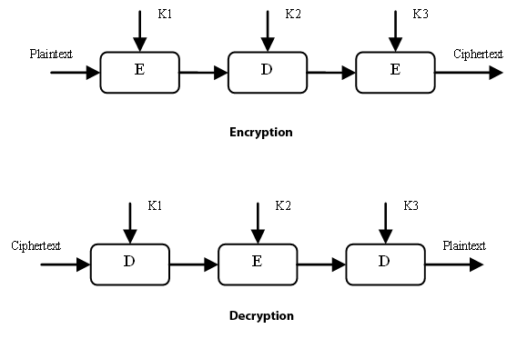
Triple DES
although are no practical attacks on two-key Triple-DES have some indications
can use Triple-DES with Three-Keys to avoid even these
C = E_{K3}(D_{K2}(E_{K1}(P)))
It is backward compatible
If k1=k2 →3DES with 2 keys
If k1=k2=k3 → single DES
has been adopted by some Internet applications, eg PGP, S/MIME

Slide 27
Triple DES
This achievement signaled the end of DES; although Triple DES, or DES repeated three times with different keys and therefore essentially a 168-bit key, is still acceptable for federal use until 2030.

